Slide 1

Socio-Technical Innovation Bundles To
Accelerate Digital Agri-Food Systems Transformation
Chris Barrett
Cornell University
Earth Precision Agriculture Conference
Calgary, AB, Canada
August 11, 2026

Slide 2







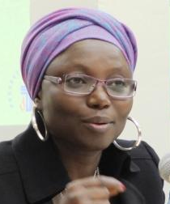



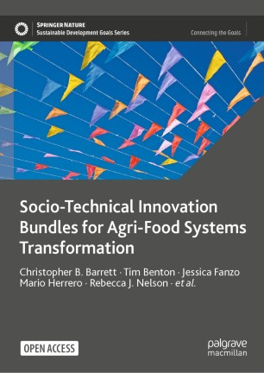












Expert panel
Cornell Atkinson – Nature Sustainability 2020 expert panel on “Innovations to Build Sustainable, Equitable, Inclusive Food Value Chains,” 23 experts across disciplines, regions, organizations, etc., w/10 additional co-authors.
Based on the”, released Dec. 2020.

Slide 3
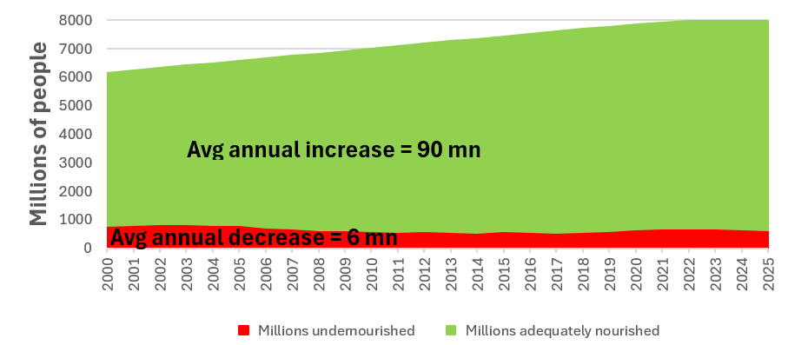
Two core truths about AFS
We must hold two fundamental truths firmly in mind:
(1) 1960s-80s public and philanthropic investments aimed to grow supply of staple cereals to avert famine. Sparked innovations that enabled unprecedented advances in human well-being.
(2) Those agrifood systems (AFS) innovations also had adverse, unsustainable spillover effects on climate, natural environment, public health/nutrition, social justice. Today’s objectives for tomorrow cannot be yesterday’s.

Slide 4
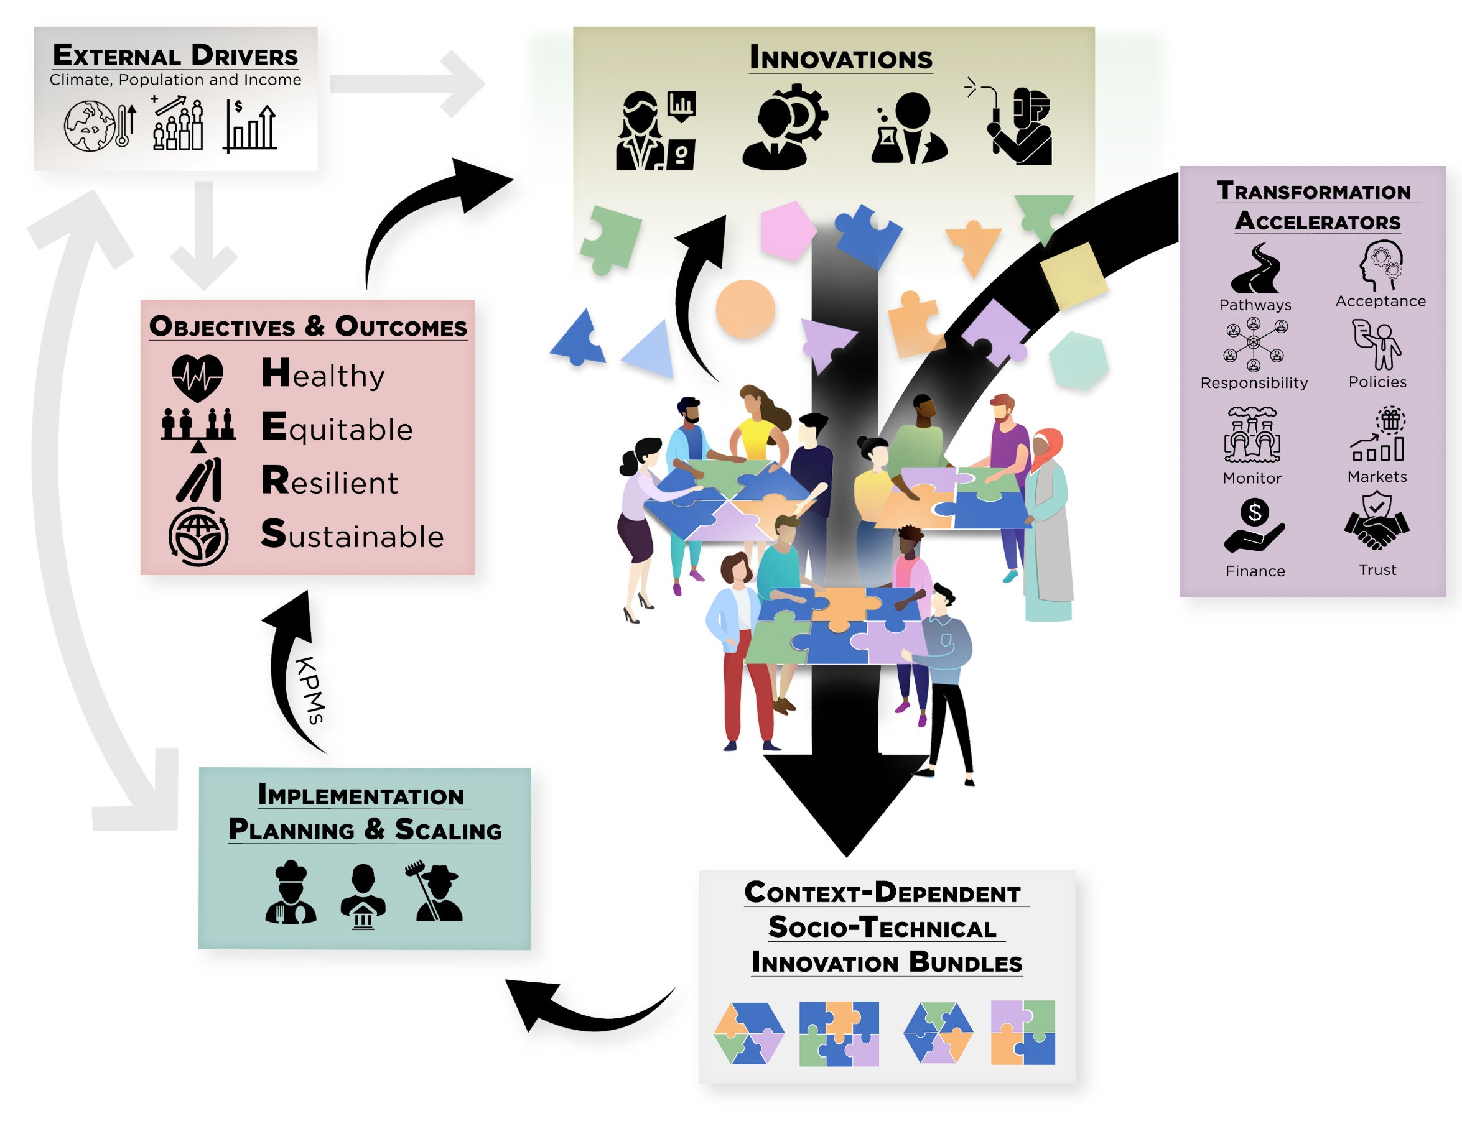
Updated objectives
We must update objectives, accelerate/reorient AFS innovations to promote productivity growth that yields healthy, equitable, resilient and sustainable (HERS) agri-food systems.

Slide 5
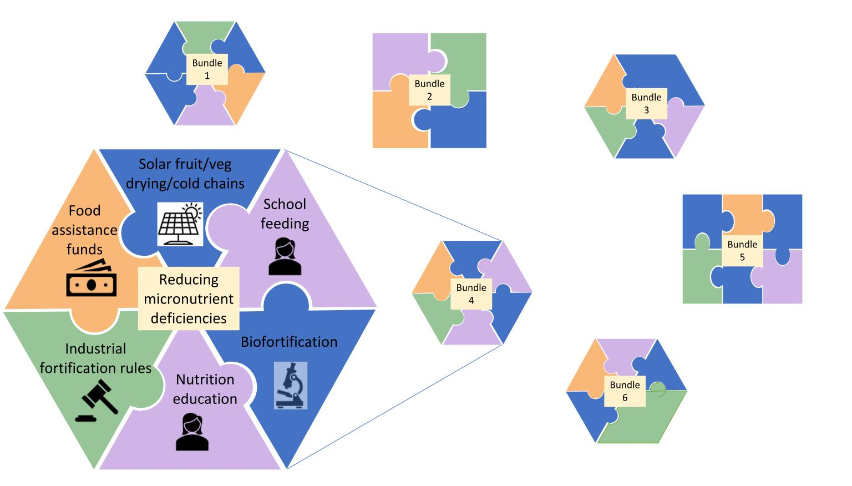
7 Essential Actions
Digital innovation key to HERS AFS transformation.
Develop socio-technical innovation bundles
Why? (i) Heterogeneous needs require bundled solutions
  (ii) No magic bullets exist. Multiple constraints; relaxing just one limits progress. Must realize synergies to adapt/scale.
  (iii) Must address political economy of spillovers and creative destruction. Coalitions from bundling can overcome incumbent status quo bias

Slide 6

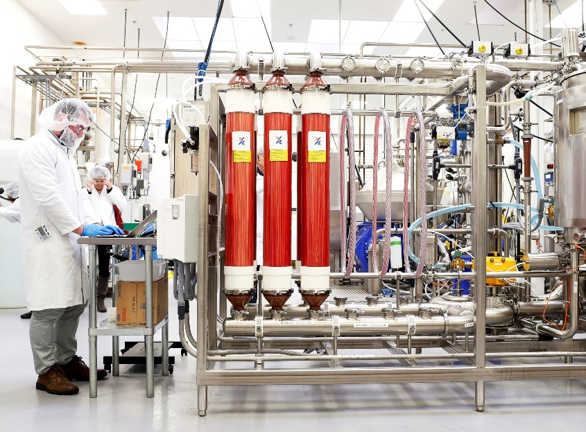
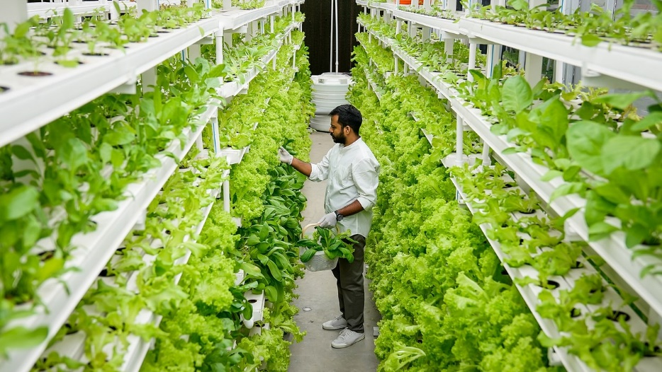
7 Essential Actions
2. Reduce the land, water and chemical footprint of food
Decoupling food production from land, water and synthetic chemicals is increasingly culturally, economically, technologically feasible.
Must actively manage de-agrarianization’s creative destruction.
Photo: Beck Deifenbach/Reuters
Photo: Gerry Machen/Creative Commons
Photo: Betterindia.com

Slide 7
7 Essential Actions
3. Reconfigure public support for AFSs
Two key roles for gov’ts:
1. Invest in essential public goods and services: e.g., R&D
2. Facilitate dialogue to find cooperative solutions
Much current government AFS spending is wasteful producer payments/subsidies (>$2bn/day!). Redirect towards social protection programs, AFS research, and physical/institutional infrastructure. Starts w/current US Farm Bill cycle and WH Hunger conference.
Foster civil society dialogues to identify and support contextually appropriate socio-technical bundles. Rising popular distrust of AI compels dialogues about guardrails on its use.

Slide 8
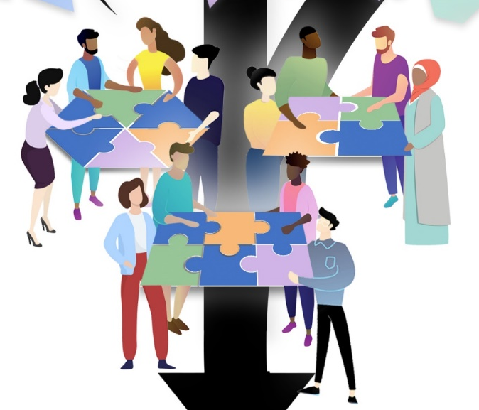
Other Essential Actions
4. Commit to co-creation with shared and verifiable responsibility Agreed KPMs, safety nets, penalties can accelerate beneficial innovation and minimize adverse unintended consequences.
5. Deconcentrate power
Reducing market and political power imbalances and broadening participation in innovation dialogues can accelerate innovation.
6. Mainstream systemic risk management
COVID-19, commodity price shocks from Russia-Ukraine and US-Iran wars underscore the rising importance of effective systemic risk management. Need innovative risk reduction and risk transfer mechanisms.
7. Develop novel financing mechanisms
AFS innovations require hundreds of $ billions annually.
How to mobilize private resources beyond philanthropy? Benevolent patent extensions, landscape bonds and other impact investment, etc.

Slide 9
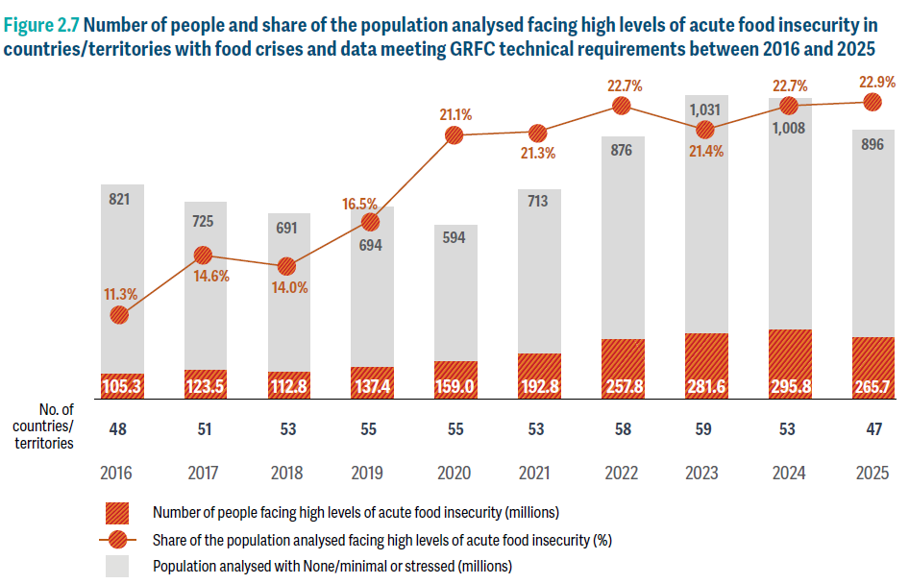
Key Near-Term Opportunity:
Humanitarian Response
Food insecurity is increasingly acute and associated with conflict in data scarce environments also vulnerable to natural disasters.
Digital tech opens up new options for (i) early warning, (ii) anticipatory action, (iii) targeting, and (iv) traceability.
Technology has outpaced mgmt systems and community buy-in. Need to bundle!
Look for soon-to-release white paper from Cornell Thought Summit on Data Science to Build Resilience and Improve Humanitarian Response.
Source:
S
Source: WFP, Global Report on Food Crises 2026

Slide 10
Thank you
Accelerating technological advances – including digital ones – is essential to HERS AFS transformation.
Must also address the need for bundling with policy/institutional
innovations that are essential complements, for multiple reasons.
Some of the biggest near-term returns will come from reducing food’s land/water/chemical footprint and in humanitarian response.
Thank you for your time and interest!

Slide 11

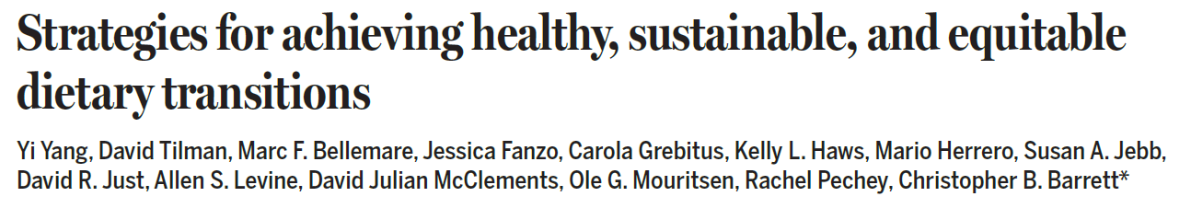
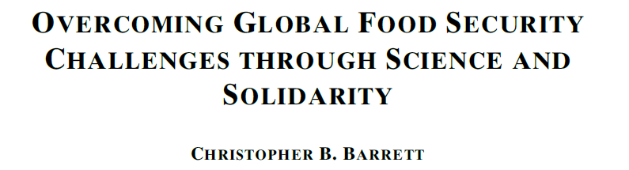
Further reading
Report and associated journal articles, videos, etc. available at https://www.atkinson.cornell.edu/projects/nature-sustainability/

